Slide 1
MS Excel Charts
Representing data Graphically

Slide 2
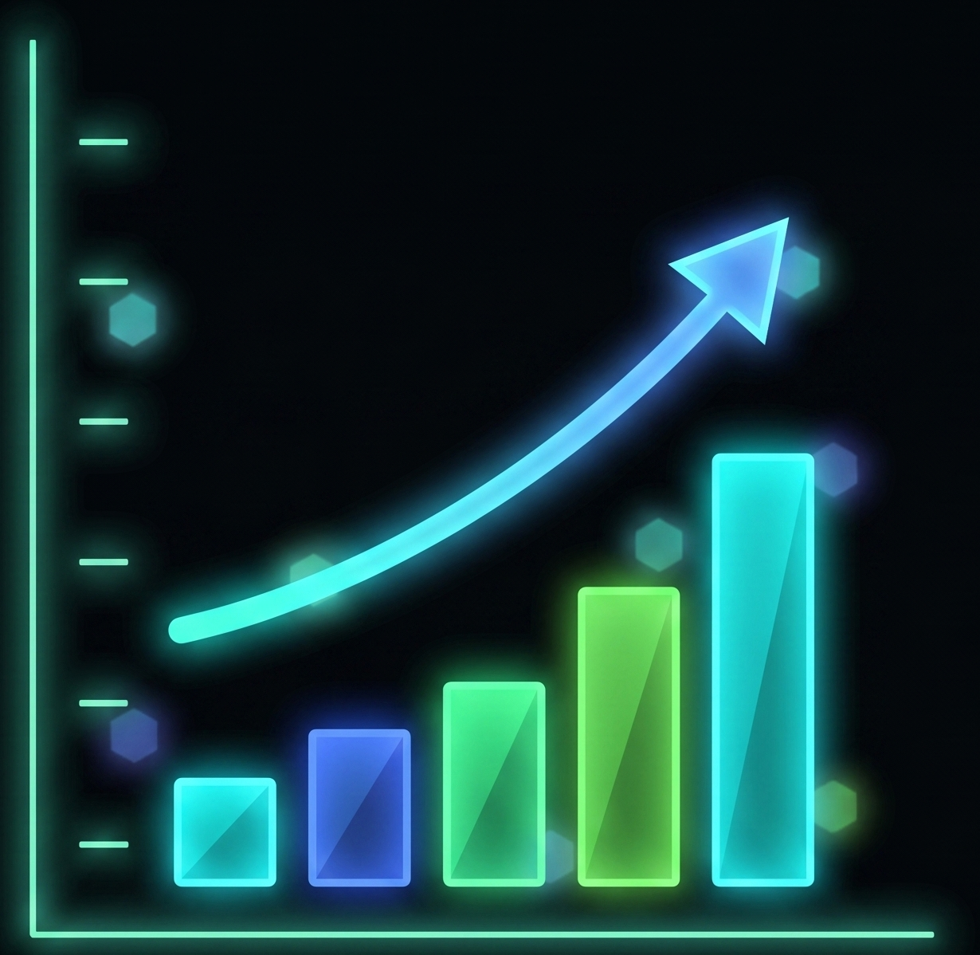
What is chart ?
Charts in MS Excel are used to make a graphical representation of any set of data.
A chart is a visual representation of data in which the data is represented by symbols.
Common symbols include bars in a bar chart or continuous lines in a line chart.
Navigation: You can easily find the Charts group under the Insert tab in the Ribbon.

Slide 3
Excel chart types
Column Chart Bar Chart
Line Chart Area Chart
Pie Chart XY (Scatter) Chart
Doughnut Chart

Slide 4
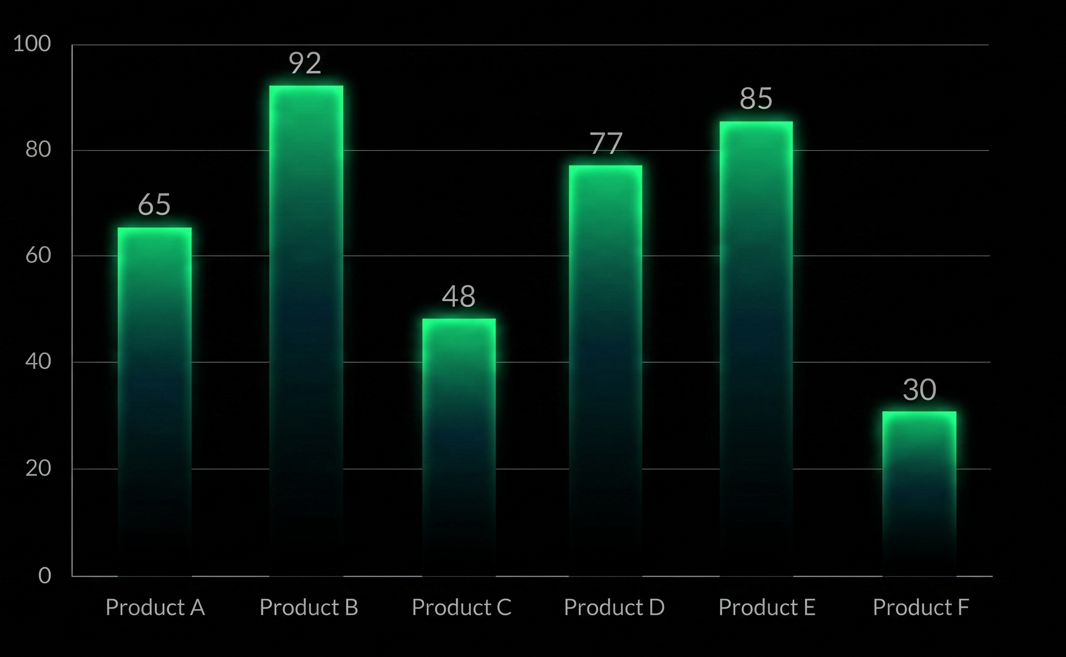
Column chart
A column chart typically displays the categories along the horizontal (category) axis.
The values are measured and displayed along the vertical (value) axis. It is highly effective for showing data changes over a period of time or for illustrating comparisons.

Slide 5
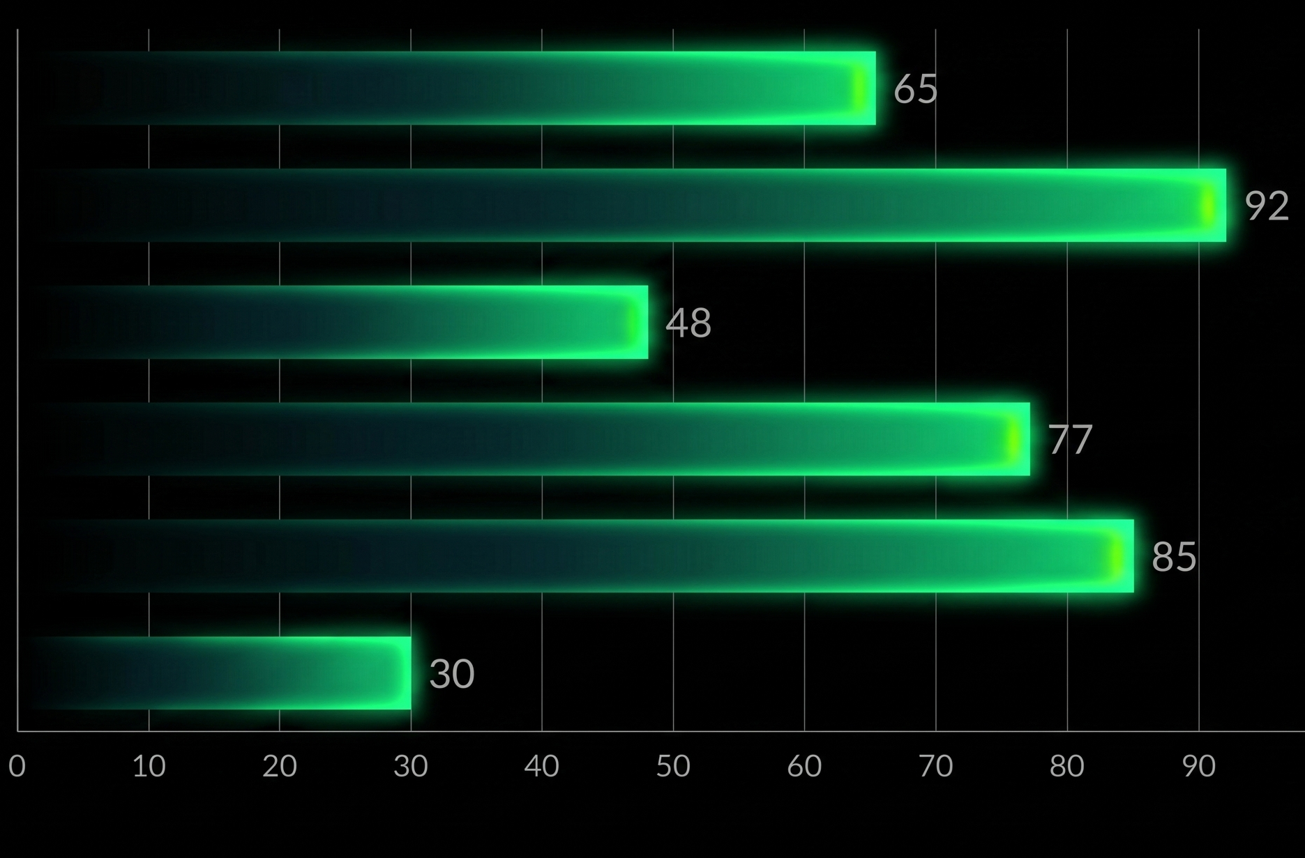
Bar chart
Bar chart illustrate comparisons among individual items ,functionally similarly to column chart but showing data horizontally
In a bar chart ,the categories are organized along the vertical axis and the values are organized along the horizontal axis

Slide 6
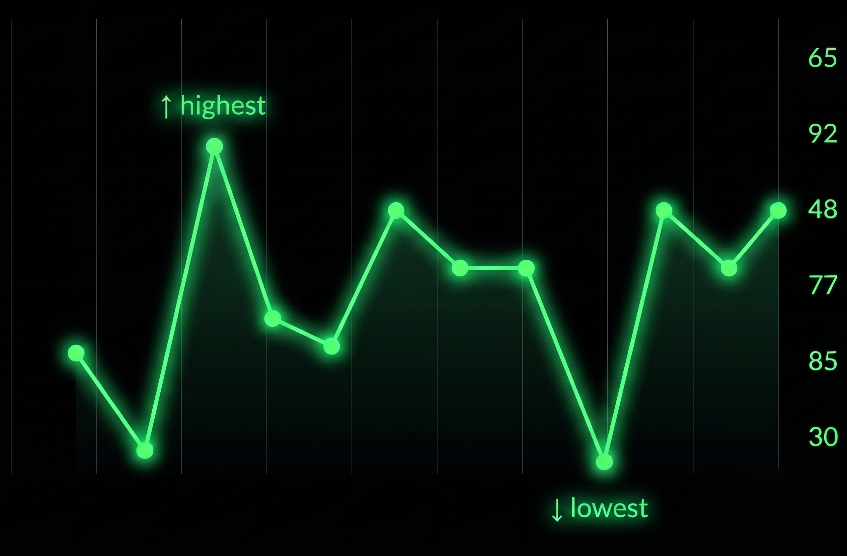
Line chart
Line Charts can show continuous data over time on an evenly scaled axis
Therefore , they are ideal for showing trends in data at equal intervals, such as months, quarters .
Each point on the line corresponds to a specific value at a given interval, and the connecting lines illustrate the direction and rate of change

Slide 7
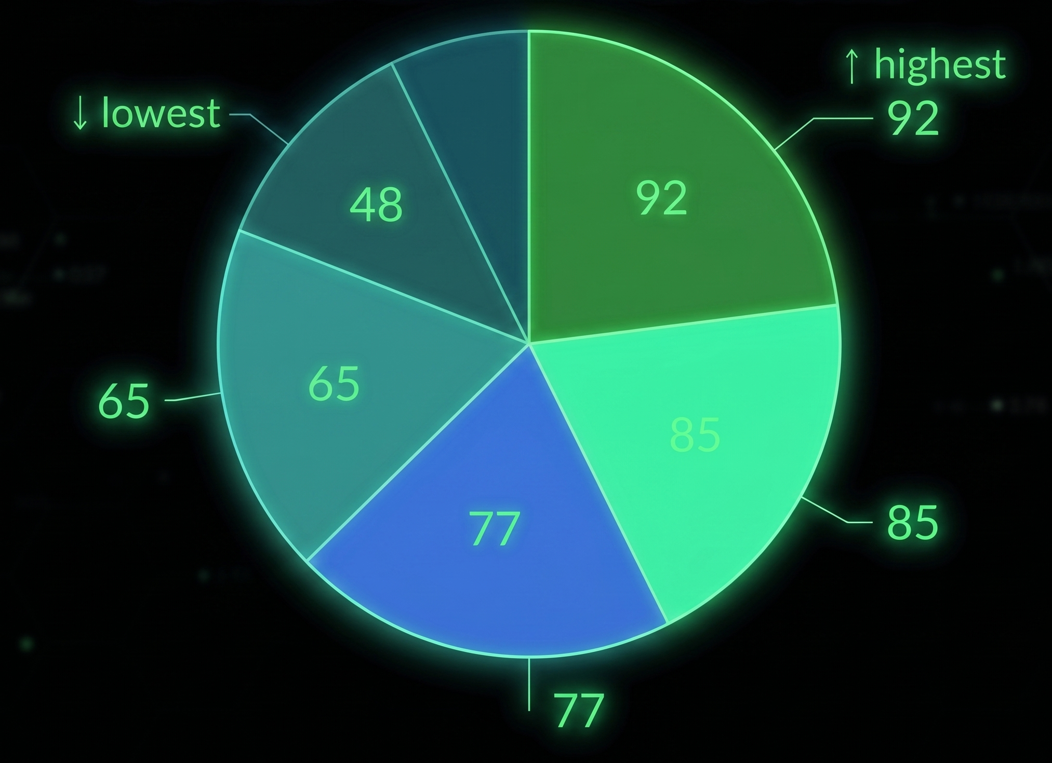
Pie chart
A pie chart represents data as a circle, where the whole circle accounts for 100 percent.
Pie charts shows the size of items in one data series, strictly proportional to the sum of items.
The data points in a pie chart are visually shown as a percentage of the whole pie .

Slide 8

Xy (scatter) chart
Purpose & Application:
XY (Scatter) charts are typically used for showing and comparing numeric values like scientific, statistical, and engineering data.
Structure:
A scatter chart distinctly has two value axes:
• Horizontal (X) value axis
• Vertical (Y) value axis

Slide 9
Thank you
Presented by Sonu Kumar Murmu

